Slide 1
OVERVIEW OF COMPUTER SYSTEMS
HARDWARE AND SOFTWARE
CSC 130 – Scientific Programming
Unit 1 – Overview of Computer Systems –
Hardware and Software

Slide 2
LEARNING OBJECTIVES
LO1.1. – List computer operations
LO1.2. – Classify computer components
LO1.3. – Illustrate the computer structure
LO1.4. – Define types of software
LO 1.5. – Classify software programs
LO 1.6. – Discuss use of computers
LO 1.7. – Examine types of applications
LO 1.8. – Discuss use of computers
LO 1.8. – Evaluate hardware and software components in today’s computers
LO 1.10. – Design an ideal computer configuration
CSC 130 – Scientific Programming

Slide 3
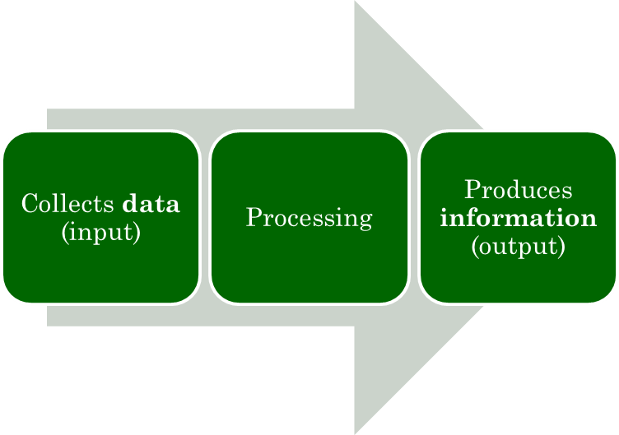
DEFINITION OF A COMPUTER
A computer is an electronic device operating under the control of instructions stored in its own memory.
Computer system consists of hardware and software
Information Processing Cycle
CSC 130 – Scientific Programming

Slide 4
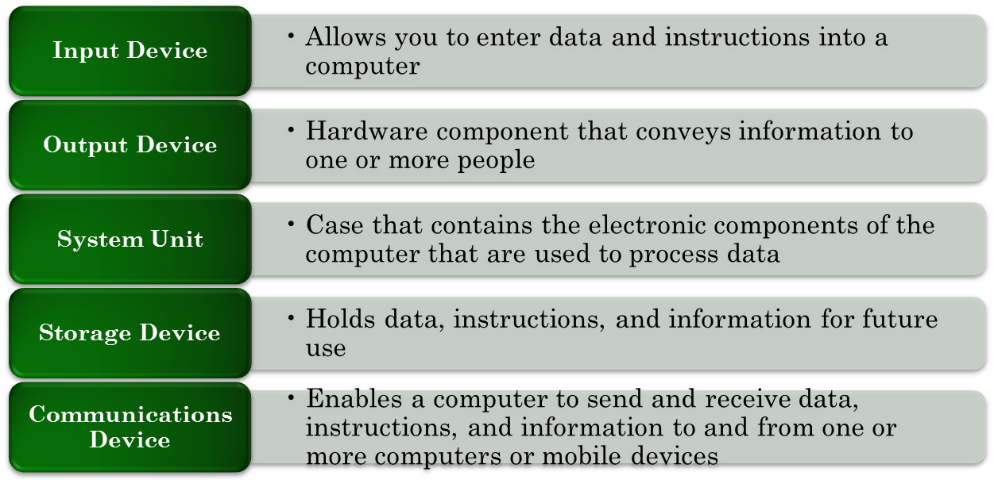
THE COMPONENTS OF A COMPUTER
A computer contains a collection of electric, electronic and mechanical components that define the hardware.
CSC 130 – Scientific Programming

Slide 5
HARDWARE COMPONENTS
The processor – CPU (central processing unit)
  Processes a program’s instructions
  Has a specific set of very simple instructions
  Determines the computational program of the entire machine
Memory:
  Storage device holding:
    Programs
    Data for the computer to process
    Results of intermediate processing
  Types of memory
    Main memory (RAM – random access memory)
    Auxiliary memory
CSC 130 – Scientific Programming

Slide 6
HARDWARE COMPONENTS
Main memory
  RAM
  Cache
Auxiliary memory (secondary memory)
  Non-volative
  Various devices:
    Disk drives
    CDs
    DVDs
    Flash drives
    Magnetic tape
CSC 130 – Scientific Programming

Slide 7
HARDWARE COMPONENTS
Input devices – facilitate input of data into the computer:
  Keyboard
  Mouse
  Microphone
Output devices – transfer data to the user:
  Monitor
  Printer
  Speakers
Communication devices:
  Facilitate external communication through various medium (cable, wireless, etc)
CSC 130 – Scientific Programming

Slide 8
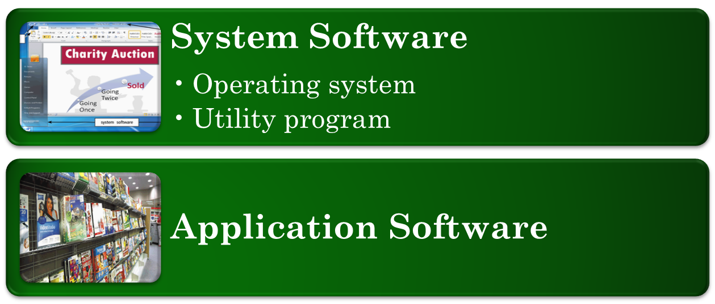
COMPUTER SOFTWARE
Software – program – is the component that directs the tasks that the computer has to perform, and how to do it
CSC 130 – Scientific Programming

Slide 9
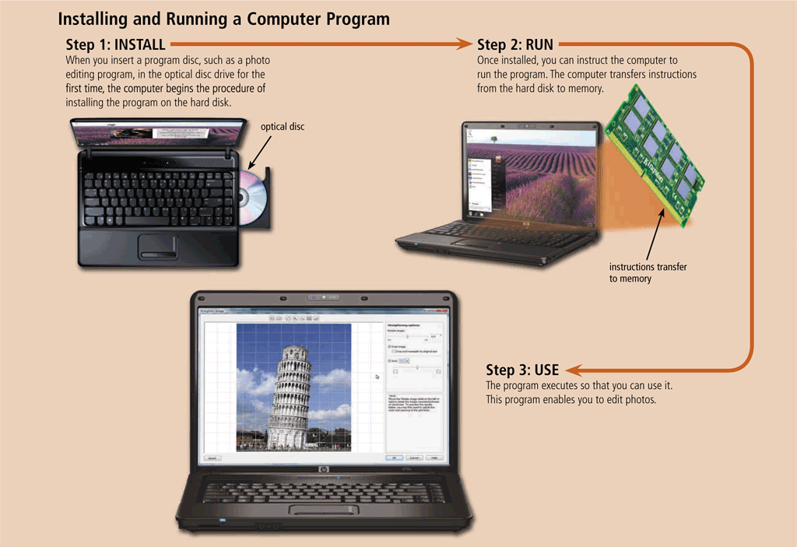
COMPUTER SOFTWARE
Software has to be install on the computer
The installation implies setting up the software to work with the computer, and all its devices
CSC 130 – Scientific Programming

Slide 10
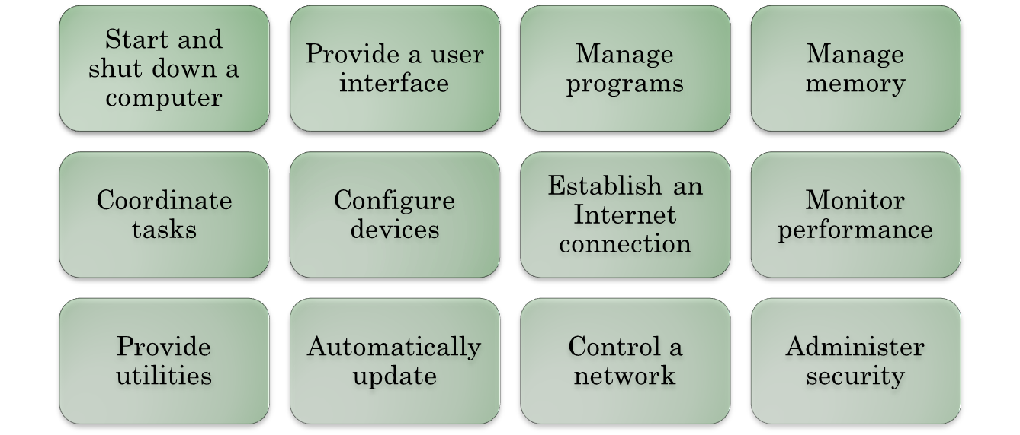
OPERATING SYSTEMS
OS – set of programs containing modules that work together to coordinate all the activities among computer hardware resources, and facilitate user’s access to all devices
CSC 130 – Scientific Programming

Slide 11
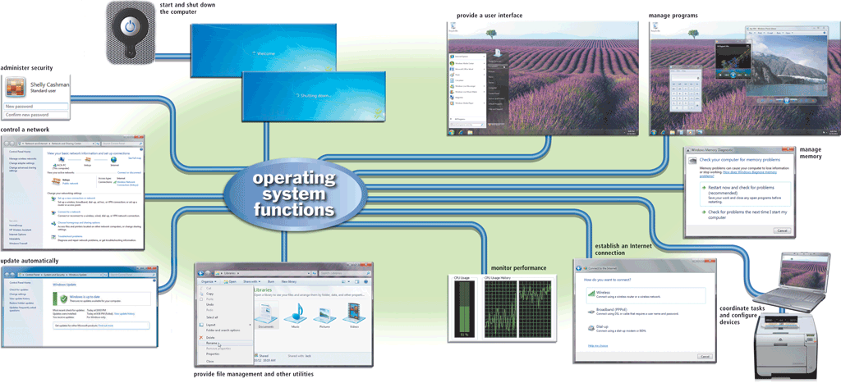
OPERATING SYSTEMS
CSC 130 – Scientific Programming

Slide 12
OPERATING SYSTEMS FUNCTIONS
Starting or restarting a computer – booting:
  Cold boot – turning on a computer that is powered off
  Warm boot – using the OS to restart the computer
User interface – controls how the user enters data and instructions, and how information is displayed
  Graphical user interface (GUI) – uses menus and visual images
  Command line interface – uses text-based commands
Memory management – optimizes the use of RAM
Task management – determines the order of tasks
Communication – including access to Internet
Performance monitor – assesses the functionality of various computer resources and devices.
CSC 130 – Scientific Programming

Slide 13
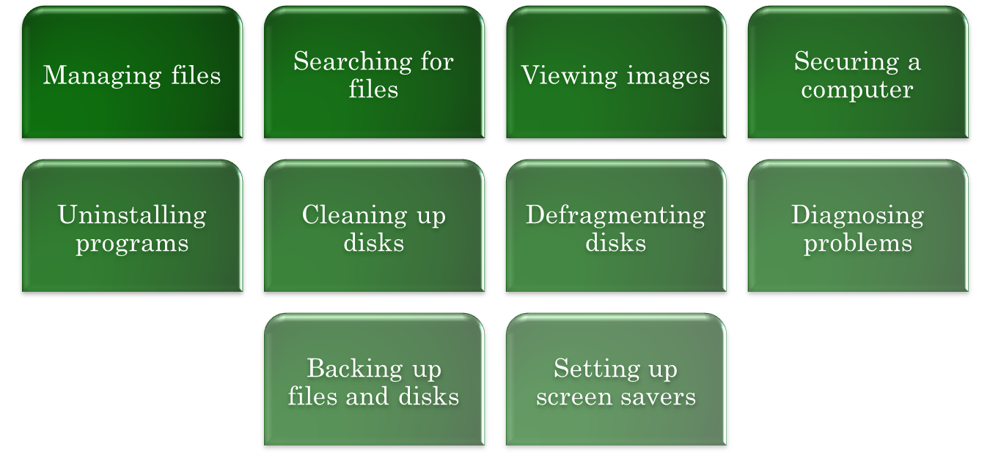
OPERATING SYSTEM FUNCTIONS
OS provides users with the capability of:
CSC 130 – Scientific Programming

Slide 14
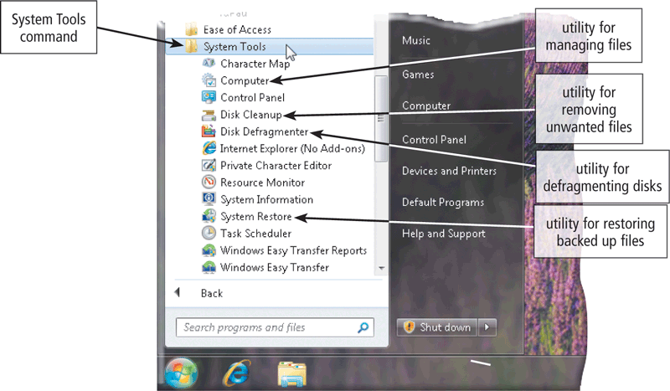
UTILITY PROGRAMS
System software that allows users to perform maintenance type tasks.
CSC 130 – Scientific Programming

Slide 15
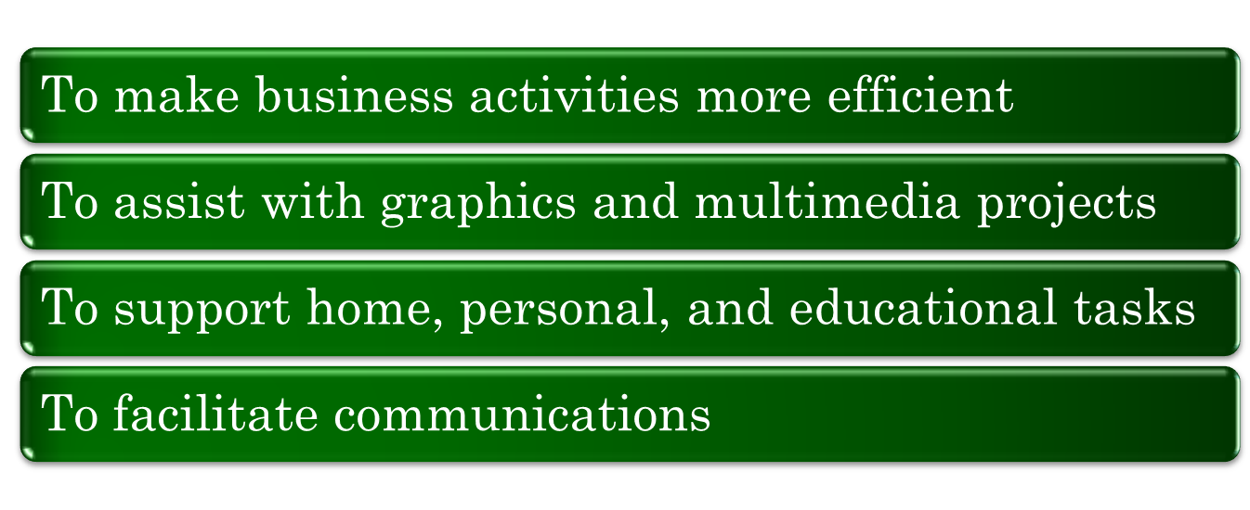
APPLICATION SOFTWARE
Consists of programs designed to make users productive and assist them with personal tasks.
CSC 130 – Scientific Programming

Slide 16
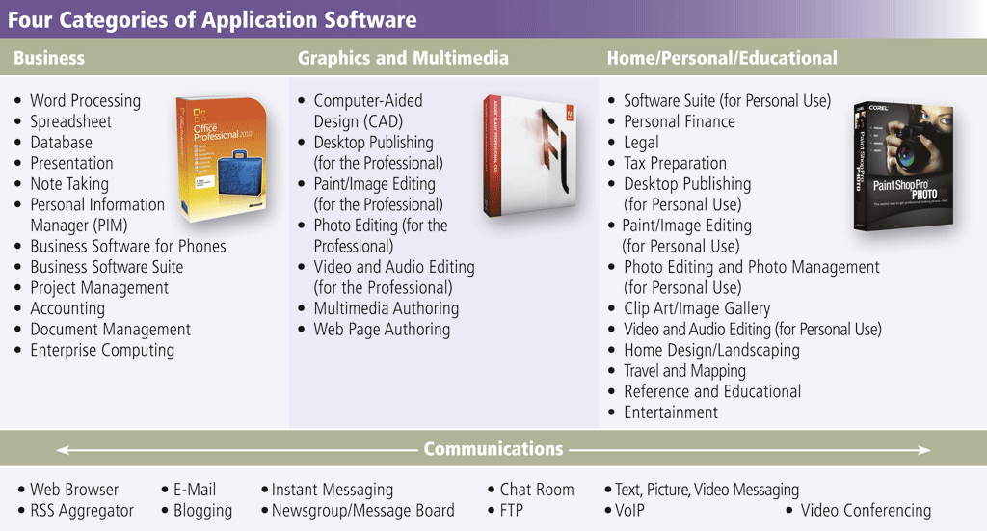
APPLICATION SOFTWARE
CSC 130 – Scientific Programming

